Slide 1
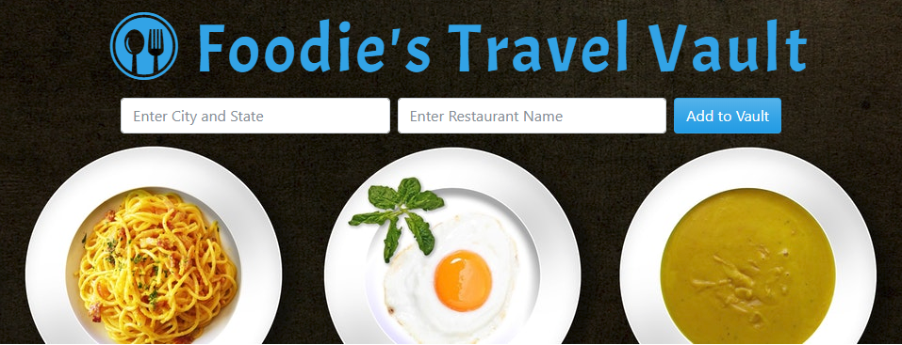
Project #1
Julia Lidstrom, Jennifer Kral, Nathan Jahnke, Jeff A. DuBois
U of M Full Stack Web Development Boot Camp
January 24, 2018

Slide 2

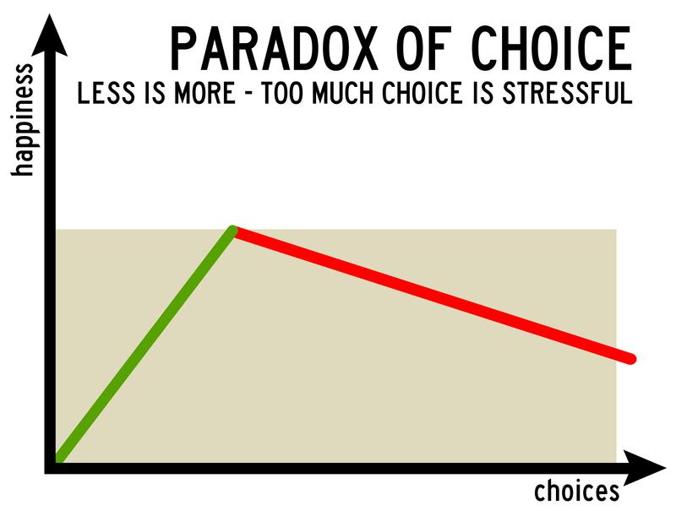
Project Inspiration
Notes:
We live in a world where information is readily available as you can research .
Let’s say you’re at home and you get hungry and don’t feel like cooking. You need to decide whether you want food delivered or you want to go out. You whip out your phone and start searching. Depending on where you live, there are multiple services that can deliver food and tens of restaurants that are open. Then you need to decide how far are you willing to drive, what type cuisine are you in the mood for, how much money are you willing to spend, and are you ok trying a restaurant with subpar rating?
It’s a lot of choices and decisions to satisfy something as simple and recurring as hunger. Next thing you know you’re not only hungry but also overwhelmed.
An American psychologist Barry Schwartz named this phenomenon a Paradox of choice arguing that eliminating consumer choices can greatly reduce anxiety.
Our app aims to reduce this choices-induced anxiety by helping people who are passionate about food and travel to finalize selection of dining options prior to the trip.

Slide 3
Original Project Concept
A complete vacation planner
Restaurants
Attractions
Places to visit
Ability to add to a calendar to create a trip itinerary
Add notes and reviews
Save the trip for future reference and sharing on social media

Slide 4
Modified Project Concept
Who?
Foodies who are strategic about planning dining options for an upcoming trip
What?
Ability to add selected restaurants to a virtual vault during trip planning
Assign a date to each restaurant that works best with a trip itinerary
Why?
Eliminate the Paradox of Choice phenomenon

Slide 5
Design Process
Developed Concept
Agreed on features for the MVP
Established timeline, milestones and deliverables
Wrote a LOT of code
Iterated based on feedback
Complete trip planner => narrowed scope to restaurants only
MVP (Minimally Viable Product):
User interface: location + restaurant search, vault
Developed 3 Phases for entire app + timeline
Working click event for our button
Button calls an API, returns data, stored in firebase, renders a restaurant card
Adding date feature to cards
Additional features
Being flexible with the project scope was critical to meeting the deadline
Setting early due dates for MVP allowed time for addl features
Notes:
Design Process - Followed a series of steps that resulted in a successful product
Concept (brainstorm, travel app enthusiasm, full app, Trip Advisor, narrowed app)
MVP features
Phase 1-3
Code writing
Overall
Brainstormed ideas, 5-10
Enthusiasm for travel app > Vacation planning app: user adds all travel destinations/tourist attractions to their home page and saves it in a calendar to reference on trip and write notes on to summarize each day or activity
> Trip Advisor > restaurants only
Once we had our idea, decided on MVP features, smallest possible app we'd be satisfied with
User interface: location + restaurant search, vault
Developed 3 Phases for entire app:
1: working click event for our button
button calls an API, returns data which gets stored in firebase, then populate a restaurant card stored in vault
2: adding a calendar or date picker for the cards
3: additional features
1-2 completed weekend before due date, allowing us time for 3
addl features: autocompletes, deleting cards
And then in writing the code we worked together via slack to review eachothers code and push to a shared repo
Overall: setting goals to complete MVP phases early allowed us to develop some cool additional features
such as the autocompletes and deleting cards

Slide 6
Technologies
Coding Requirements | Technologies Used
Must use at least two APIs | Yelp Businesses Search API Google Maps API
Must use AJAX to pull data | Used https://cors-anywhere.herokuapp.com
Must utilize at least one new library or technology | Flat Icon Font Awesome Star Rating jQuery Library jQuery DatePicker jQuery Autocomplete
Must have a polished frontend / UI | Used a Bootswatch Cerulean theme for consistent color scheme Used media queries
Must meet good quality coding standards | Indentation Descriptive naming
Must have some sort of repeating element | Bootstrap cards displayed in a grid
Must use Bootstrap or Alternative CSS Framework | Bootstrap 4.0
Must have User Input Validation | Three input fields with an auto-complete

Slide 7
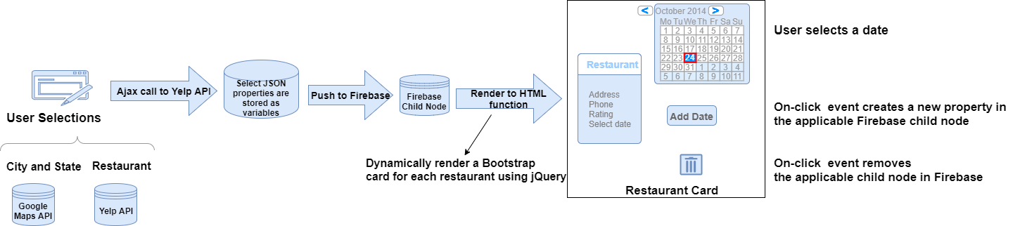

Data Flow
APIs
Auto-complete on both input fields
If a restaurant has multiple locations, user is able to select the correct one from the list.
Firebase
Each restaurant object is saved as a child node
Stored parameters are used to render restaurant cards
Each child object is updated with date or can be deleted from the Firebase

Slide 8
DEMO

Slide 9
Difficulties & Solutions:
Trip Advisor API unavailable
Solution: Changed scope of app
Yelp API unavailable for client side API calls
Used proxy server Heroku + CORS

Slide 10
Future Features
Pop-up screen on hover with restaurant hours of operation
Image to contain a restaurant’s website URL instead of a Yelp search result
Sorting the vault: filters to view restaurants by date, name, etc
Add a Notes text field to each restaurant card to add user reviews/summaries
Archive card for a visited restaurant

